Slide 1
LUNG CANCER PREDICTION
TEAM 10
2003A51086:SAKEETH
2003A51102:BHAVANA
2003A51114:SOWMYA
2003A51092:SANDEEP

Slide 2
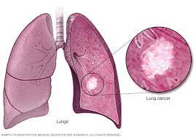
INTRODUCTION
Lung cancer is one of the deadliest diseases in history of mankind.
According to world health organization(WHO),the most common lung cancer deaths were 1.8 millon.
In india,there were 63,475 deaths annually.
Lung cancer is a type of cancer which damages lungs, which is caused due to division of cells in lungs uncontrollably.
Identification of lung cancer at early stage can help the doctors to start treatment.

Slide 3
Symptoms Of Lung Cancer
Smoking
Yellow fingers
Anxiety
Peer_pressure
Chronic Disease
Fatigue
Allergy
Wheezing
Alcohol
Coughing
Shortness of Breath
Swallowing Difficulty
Chest pain

Slide 4
Literature Survey
Ref. | Year | Preprocessing | Methods | Datasets | Results
Li et al | 2020 | lung field segmentation and rib suppression | multi-resolution patchbased CNNs were trained for lung nodule detection | Japanese Society of Radiological Technology (JSRT) database | The method can detect 99% lung nodules on JSRT database
Bhandary et al | 2020 | Morphological segmentation and watershed segmentation are used for automated nodule segmentation | MAN is used to classify chest X-Rays images and EFT is used to classify the lung CT images | Dataset of Chest X-Ray and Lung cancer (LIDCIDRI) | DL accuracy is 96% for X-Ray images while the accuracy is 97.27% for CT images

Slide 5
Ref. | Year | Preprocessing | Methods | Datasets | Results
Shakeel et al | 2019 | multilevel brightnesspreserving approach | improved deep neural network and ensemble classifier | Database of cancer imaging archive (CIA) dataset | The proposed system recognized the cancer with maximum accuracy.
Reddy et al | 2019 | Picture securing, prehandling, binarization, thresholding, division, feature extraction are applied. | The fuzzy neural system is used to test the neural system with machine learning approaches. | Dataset obtained from UCI repository | Accuracy 96.67 %.

Slide 6
About Dataset
Lung cancer dataset is taken from Kaggle.com
In this data set we have 16 attributes,284 instnces.
It also consists the symptoms of lung cancer.
We train machine to determine lung cancer with 13 symptoms.
The dataset also predict cancer in terms of gender and age.
The information given in data set is in nuberic form.

Slide 7
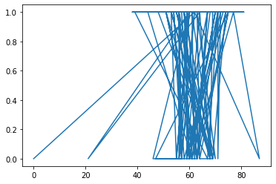
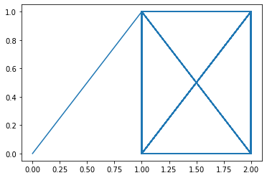
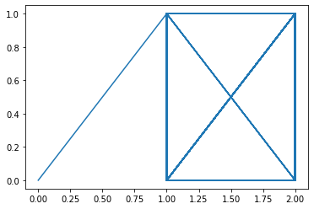
VISUALIZATION Of Dataset
In this dataset we observed the relation between the symptoms and lung cancer.
Age VS Lung cancer Smoking VS Lung cancer Yellow fingers VS Lung cancer

Slide 8
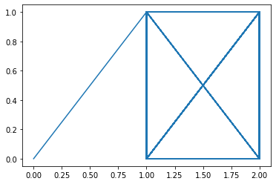
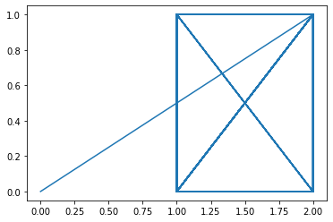


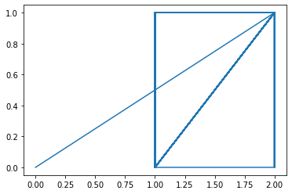

Anxeity VS Lung cancer
Peer Pressure VS Lung cancer
Chronic disease VS Lung cancer
Fatigue VS Lung cancer
Allergy VS Lung cancer
Wheezing VS Lung cancer

Slide 9



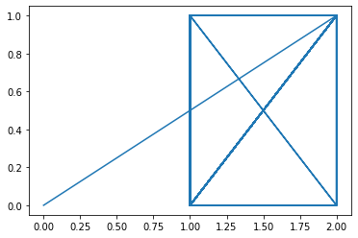

Alcohol Consuming VS Lung cancer
Coughing VS Lung cancer
Shortness of breath VS Lung cancer
Swallowing Difficulty VS Lung cancer
Chest Pain VS Lung cancer

Slide 10
LOGISTIC REGRESSION
Logical analysis extends to the relationship between the dependent variable of category and the independent set (explanatory variable). Order deletion is used when the dependent variable has only two values, such as 0 and 1 or Yes. Instead of simulating a straight line or a hyperplane, the linear regression model uses the directional function to illuminate the output of a linear equilibrium between 0 and 1. The binary model has two variables such as a pass / fail i.e. indicated by a variable, where two values are written "0" and "1". The corresponding values for the value labeled "1" may vary between 0 (certainly the value "0") and 1 (certainly the value "1"). The plural is often reserved for cases where the dependent variable has three or more different values, such as high, medium, low. Although the type of data used for a reliable variable is different than that of multiple returns, the actual usage of the process is the same. Positive discrimination competes with discriminant analysis as a category analysis. Many authors feel that visual thinking is more flexible and better suited to resistance in discriminatory research. This is because postponing the psychological order does not mean that independent variables are normally distributed, as is the case with discriminant analysis.

Slide 11
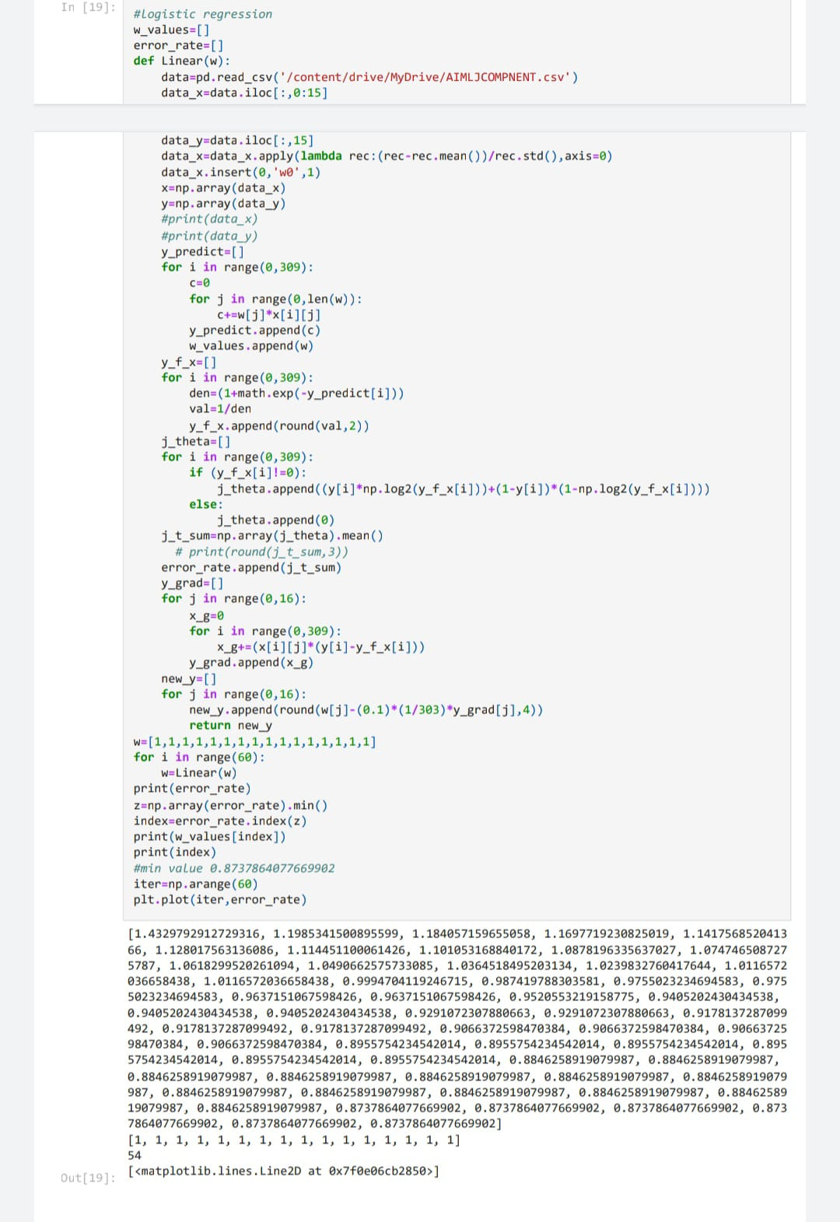
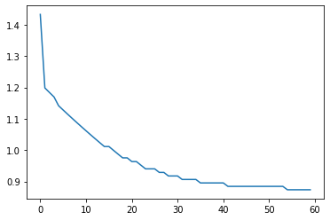

Slide 12
TRAINING AND TESTING OF DATA DECISION TREE
A decision tree is a decision support tool that uses a tree-like graph or model of decisions and their possible consequences, including chance event outcomes, resource costs, and utility. It is one way to display an algorithm.
A decision tree is a flowchart-like structure in which each internal node represents a "test" on an attribute (e.g. whether a coin flip comes up heads or tails), each branch represents the outcome of the test and each leaf node represents a class label (decision taken after computing all attributes).[4] The paths from root to leaf represent classification rules.

Slide 13
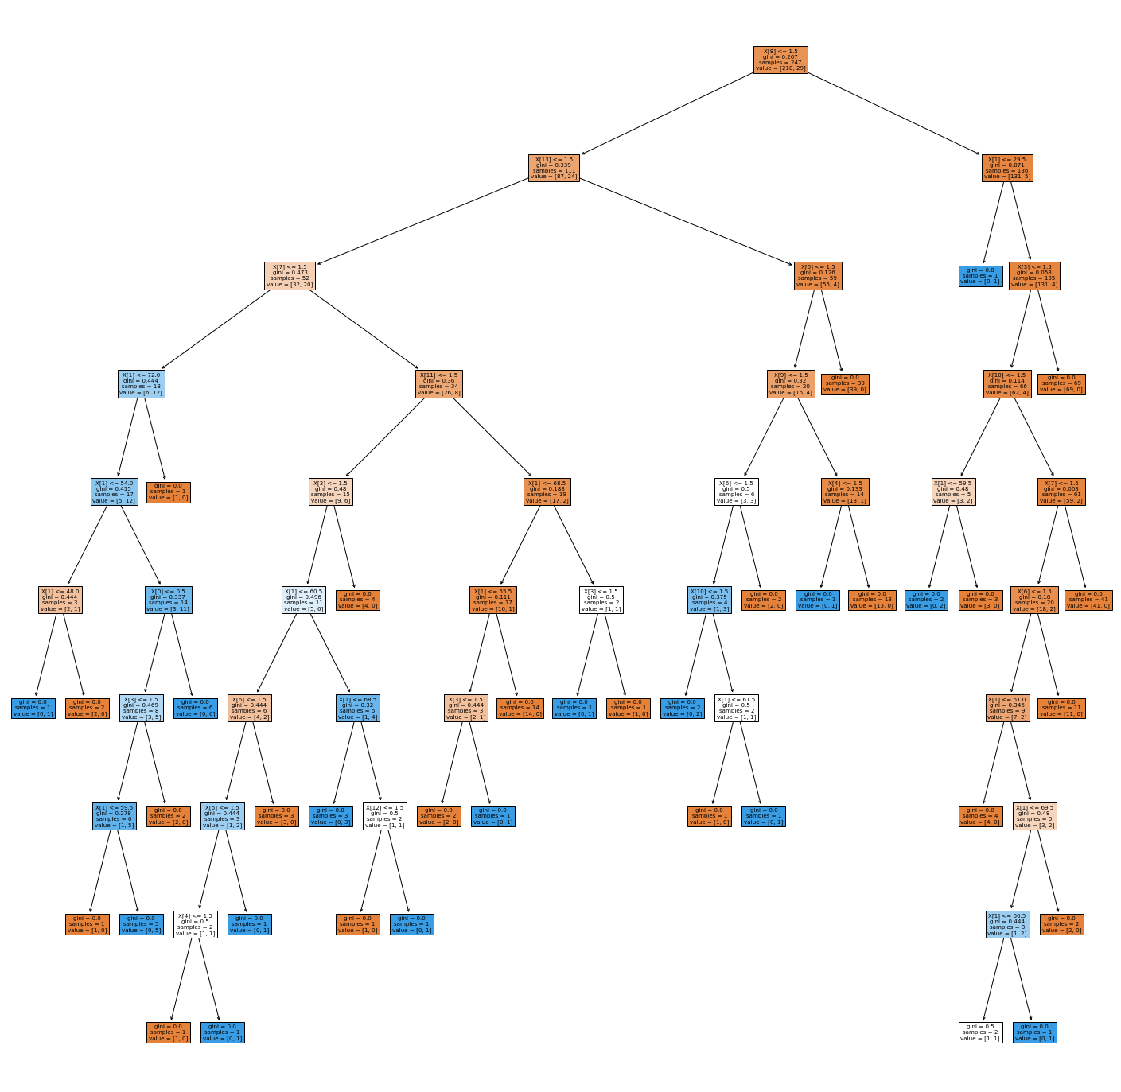

Slide 14
SUPPORT VECTOR MACHINE
In machine learning, support vector machines (SVMs, and support networks) are supervised learning models related to learning algorithms related to data analysis used and classification. Vector Machine (SVM) is a non-complicated reference line. It is supported by a mathematical learning concept. They are used to learn how to create an easy way to measure data, and to predict predictions. Binary classification is used to look at a decision boundary also known as a hyperplane that divides information into two distinct categories. Hyperplane is drawn near large points in a dataset. The SVM algorithm is a font that better separates the two classes. It involves two basic ones, namely training and testing. The SVM algorithm means that only backup weeks are important and training examples are missing. The SVM can be distributed to various databases and data points are referred to as features as having internal links data center. The algorithm uses kernel methods to convert line space into space.

Slide 15
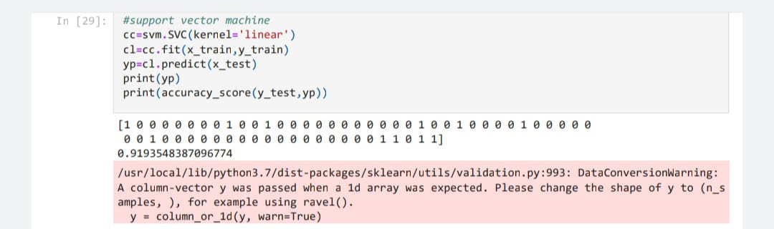

Slide 16
CONCLUSION
The effectiveness of cancer prediction system helps the people to know their cancer risk with low cost
Helps the people to take the appropriate decision based on their cancer risk status.
The logistic regression algorithm showed an accuracy of 0.9193548387096774.
SVM algorithm showed an accuracy of 0.9193548387096774.
i.e., the machine learning algorithm we implemented can predict the presence of lung cancer with 91% accuracy.

Slide 17
REFERENCES
Dataset:
https://www.kaggle.com/datasets/mysarahmadbhat/lung-cancer
Data visualization/analysis:
https://github.com/dsakeeth/aiml_jcomponent/blob/main/AIMLJC_LUNG_CANCER_PREDICTION.ipynb

Slide 18
THANK
YOU

